Slide 1
WEB PROGRAMMING
Project Presentation
Name : Nopa Islam
Id : 011 151062

Slide 2
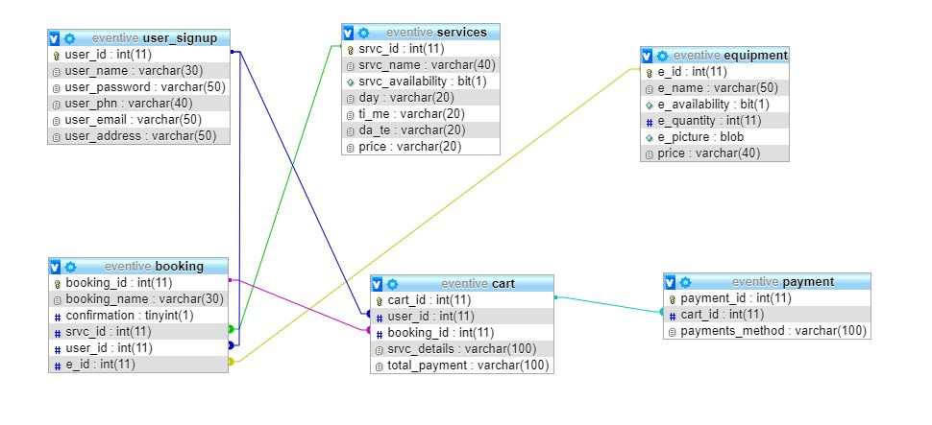
ERD

Slide 3
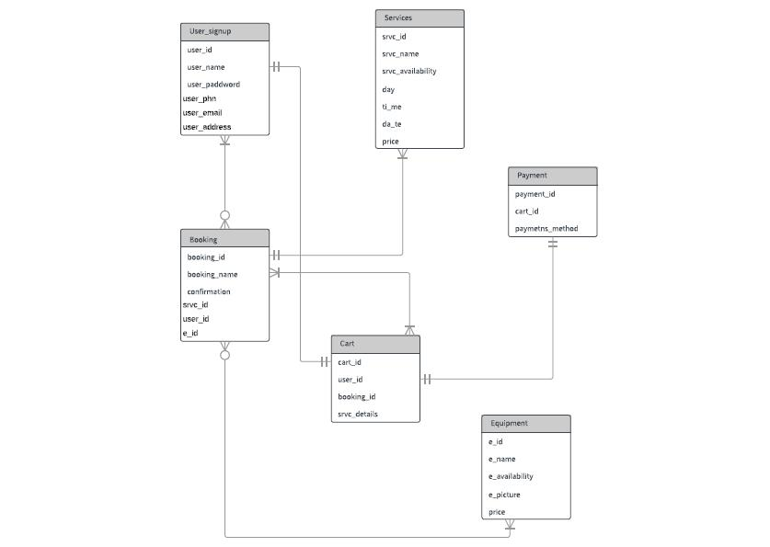
ER Diagram of the project database

Slide 4
Project Name:Eventive
Eventive is mainly an Event management site.

Slide 5
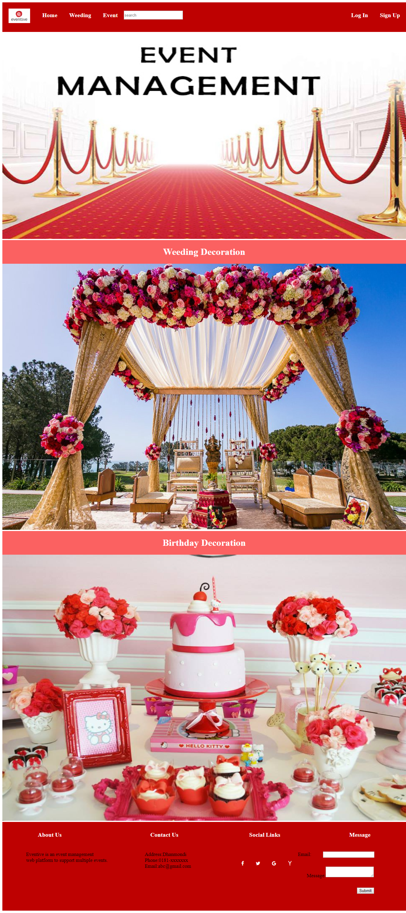
Home Page
For taking services,at 1st user will have to Log In,Sign Up from here.Here,we have wedding and birthday service providing options.

Slide 6
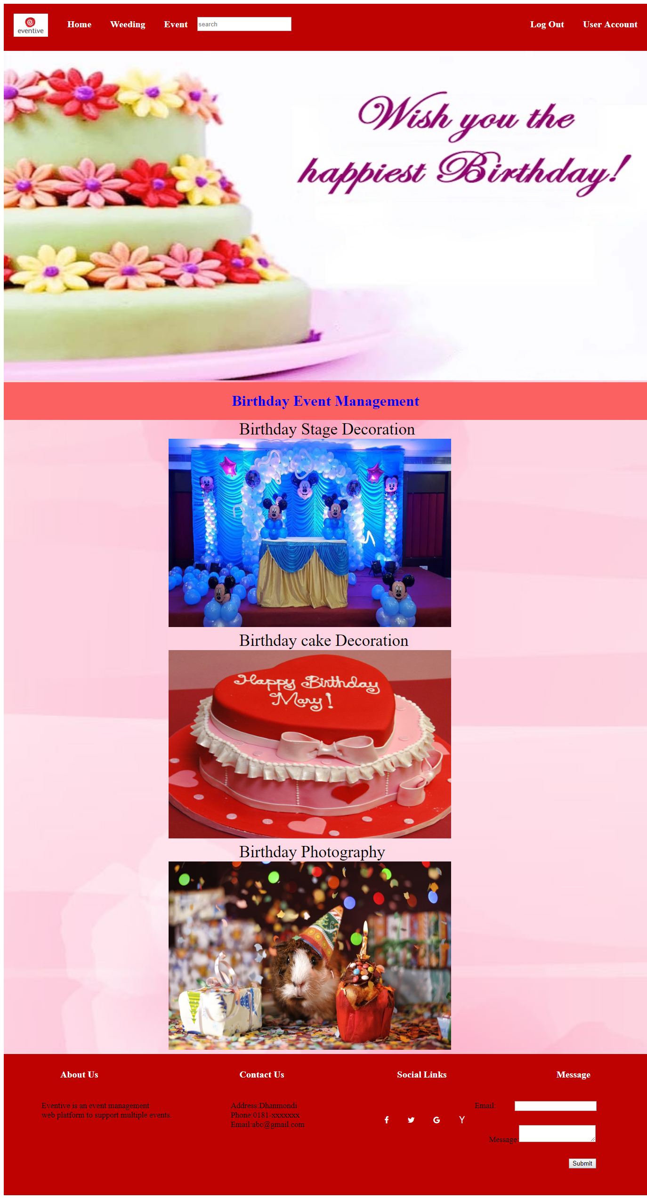
Birthday
Here,we have different options like stage,cake decoration and birthday photography options.By clicking Birthday Event Management button a user can go to birthday_form page and select and take these services.

Slide 7
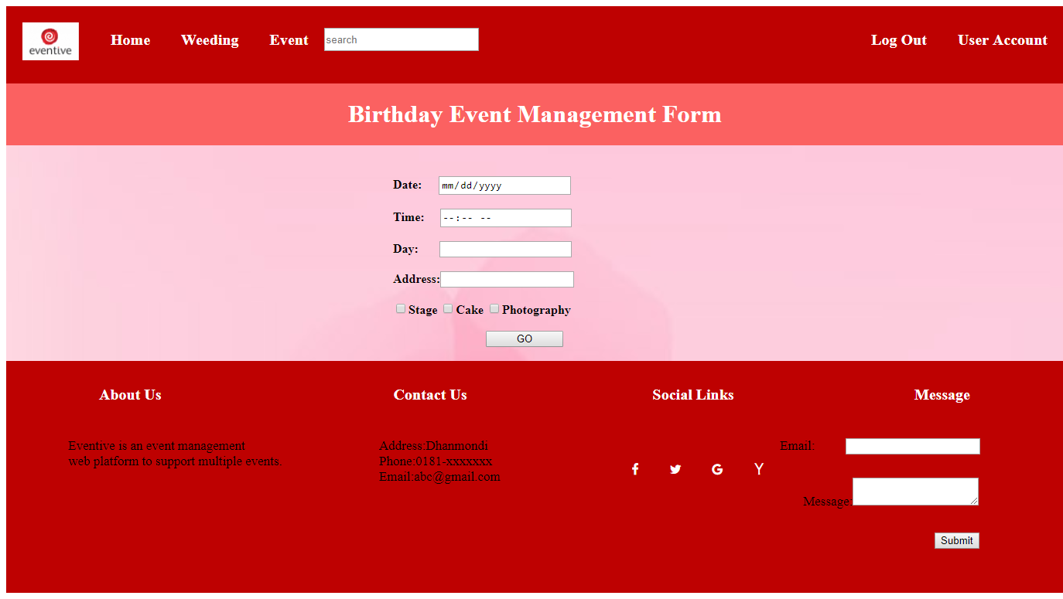
Birthday_Form
By filling up the table and pressing the go button form will be submitted and it will give a resuest to admin and if admin approves the request then that specific category service will be added to user’s cart.
A user can also give a message to admin by using email which has been given in the footer section. A user can also search for services.

Slide 8

Wedding
Here,we have different options like stage,car,venue,holud decoration and wedding photography options.By clicking Wedding Event Management button a user can go to wedding_form page and select and take these services.

Slide 9
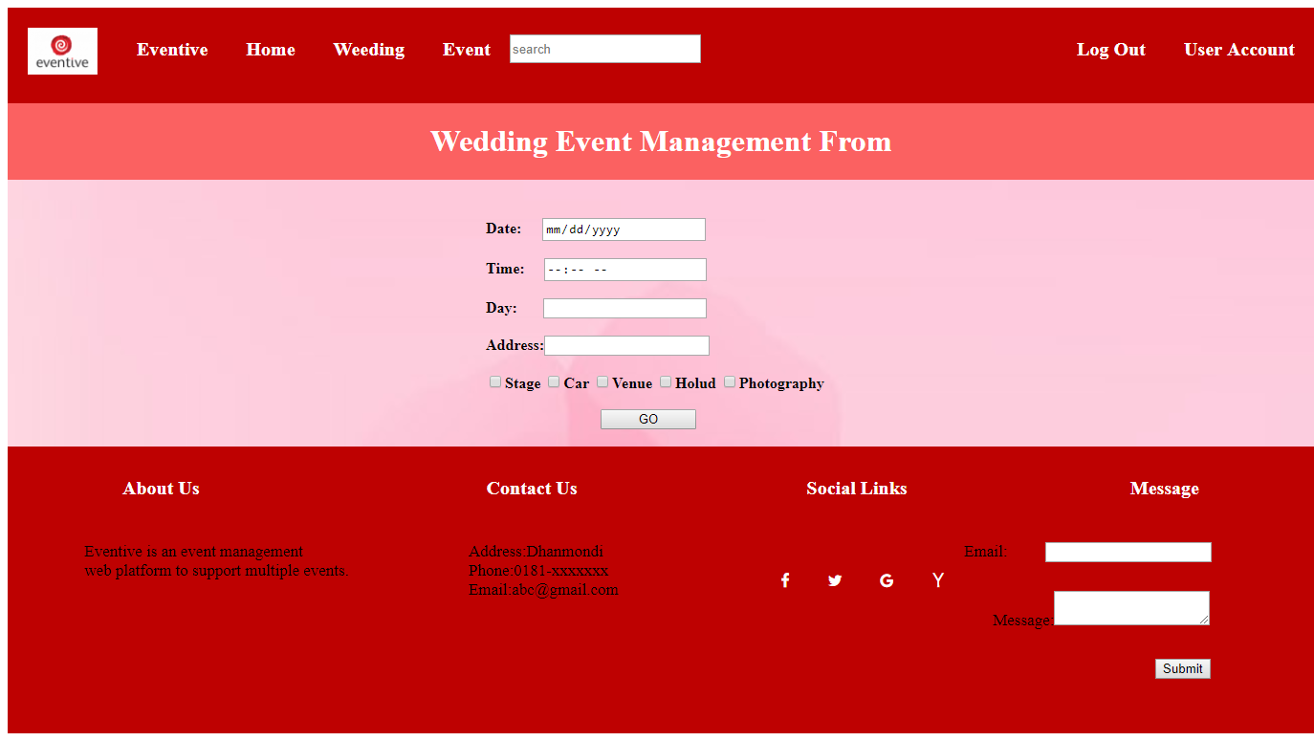
Wedding_Form
By filling up the table and pressing the go button form will be submitted and it will give a resuest to admin and if admin approves the request then that specific category service will be added to user’s cart.

Slide 10
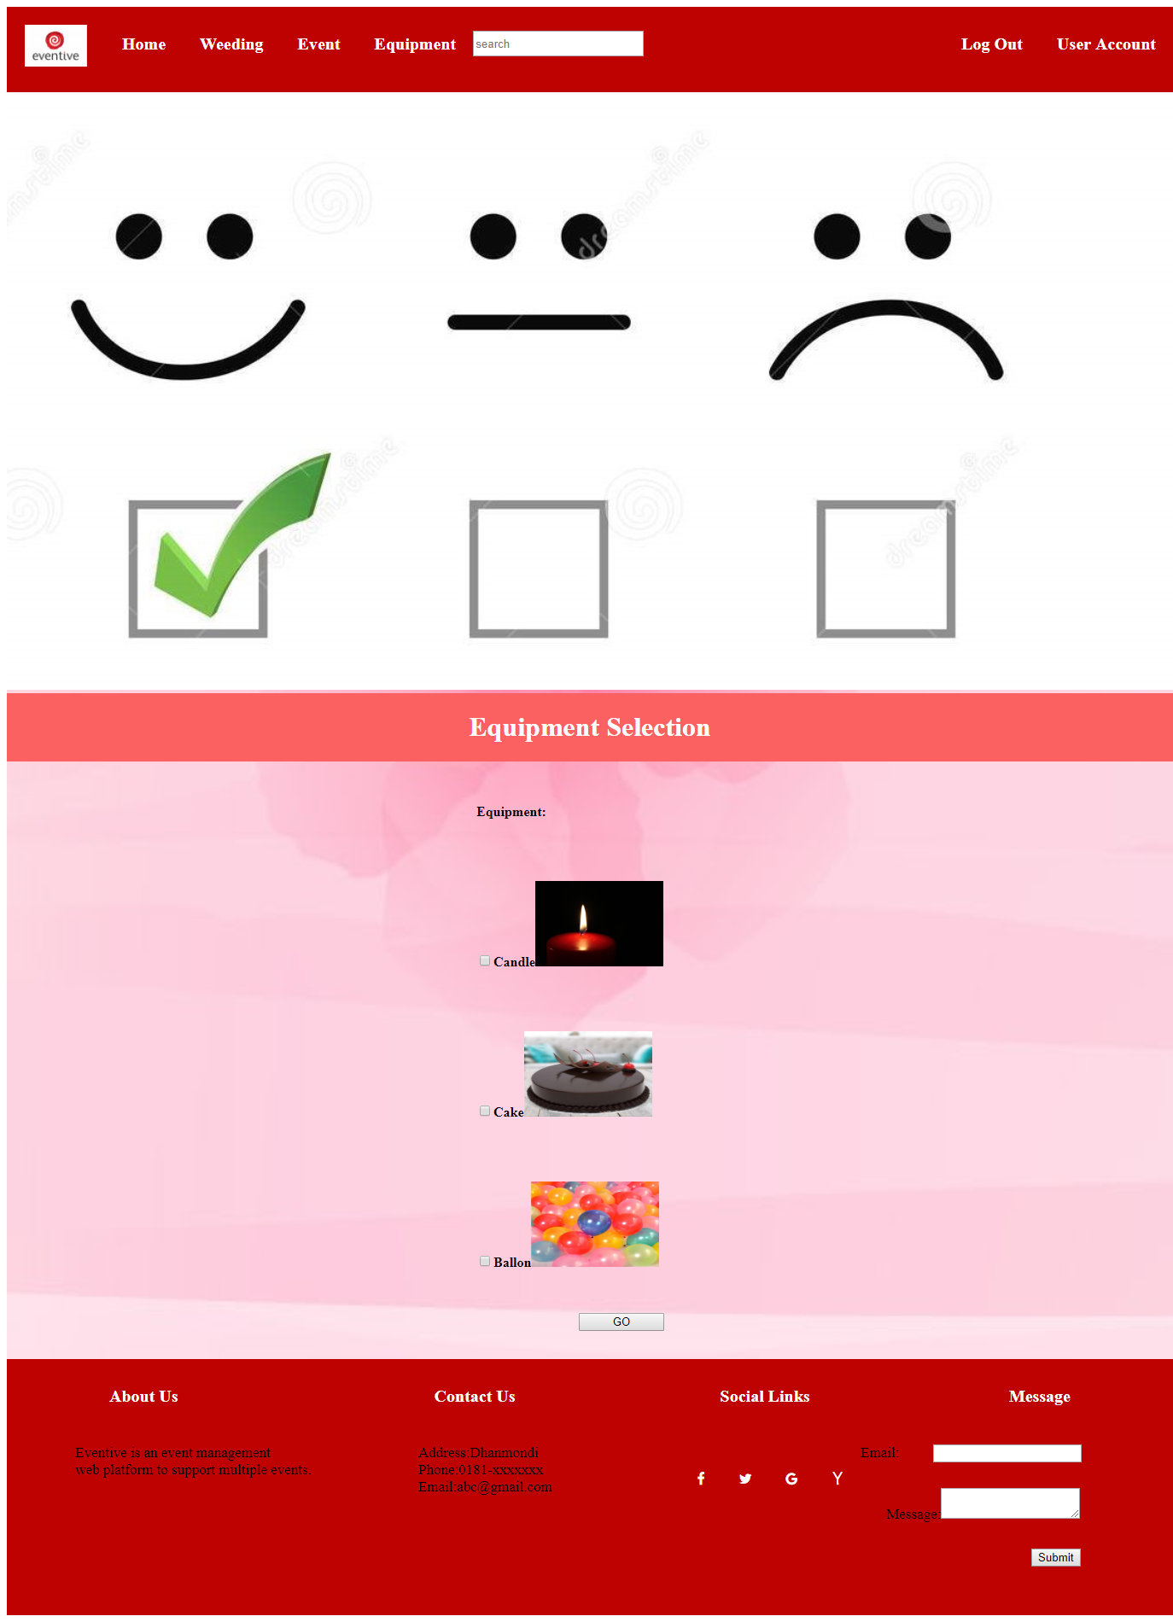
Equipment
Here,we have equipment button in header.If user needs any kind of equipment then they can select these and by pressing go button it will give admin a request and if admin approves then it will be added to the cart.

Slide 11
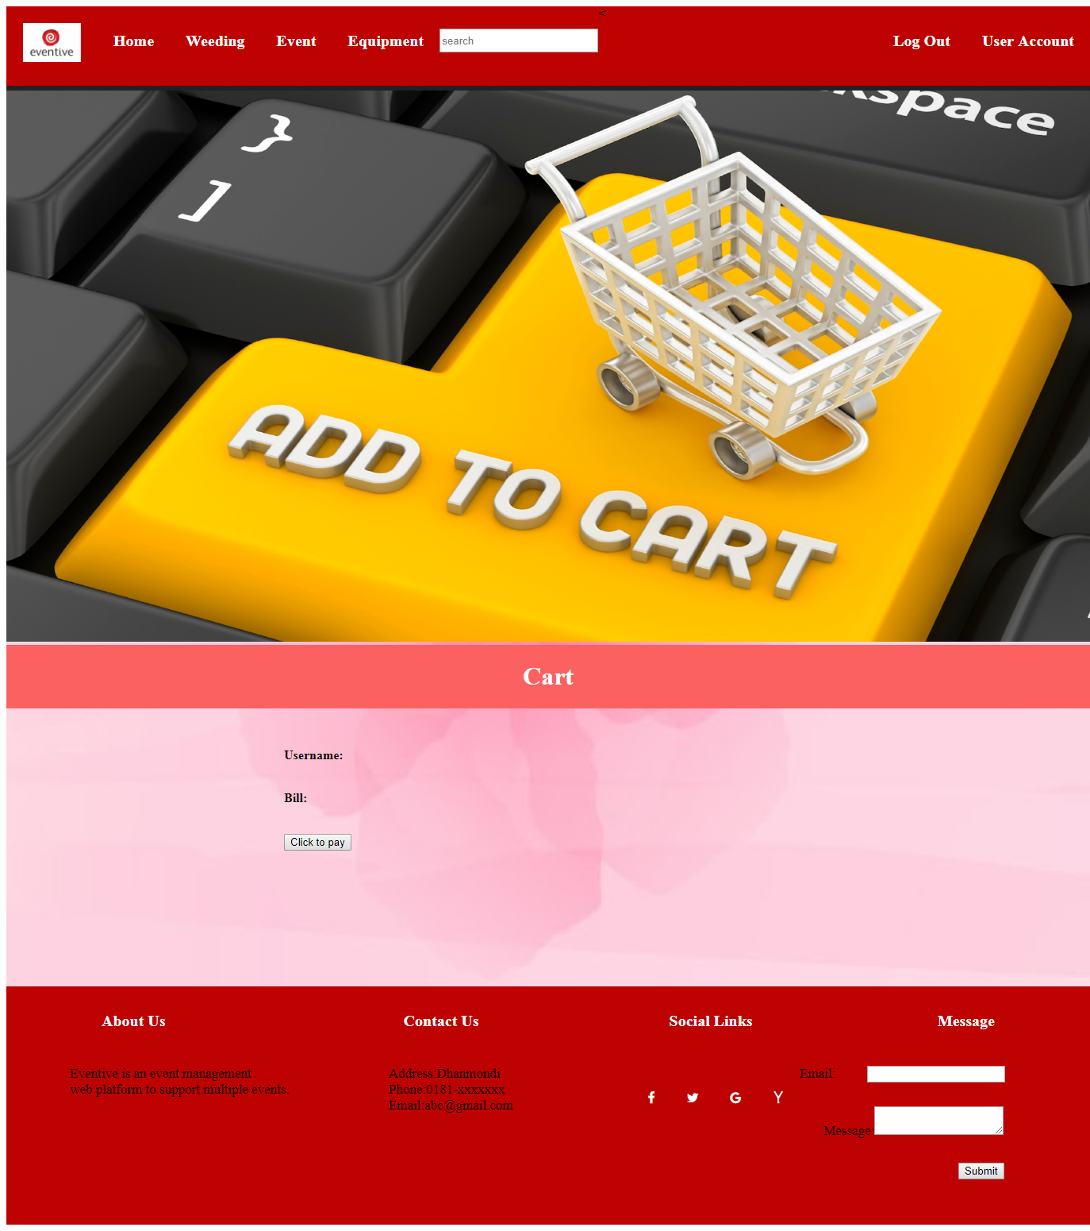
Cart
From database,by performing query we will get the user’s info and total bill then if user clicks the pay button then it will redirect them to the payment page.

Slide 12
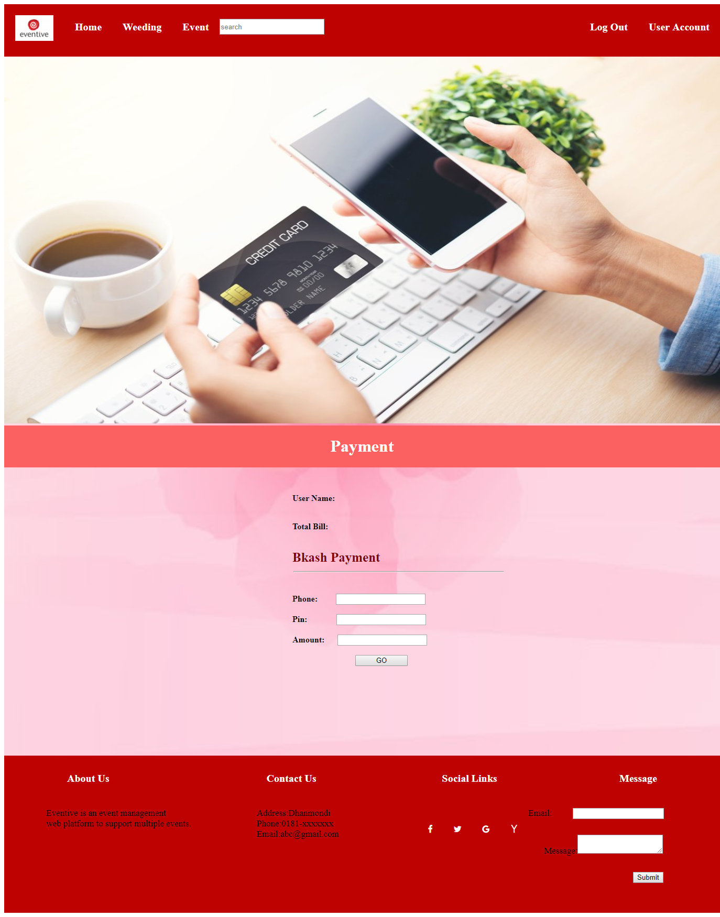
Payment
From database,by performing query we will get the user’s info and total bill.I have added one option here and it is Bkash payment.By filling up this form and pressing go button it will give admin a request and if admin approves then it will give a pop up window and it will show payment successful.

Slide 13
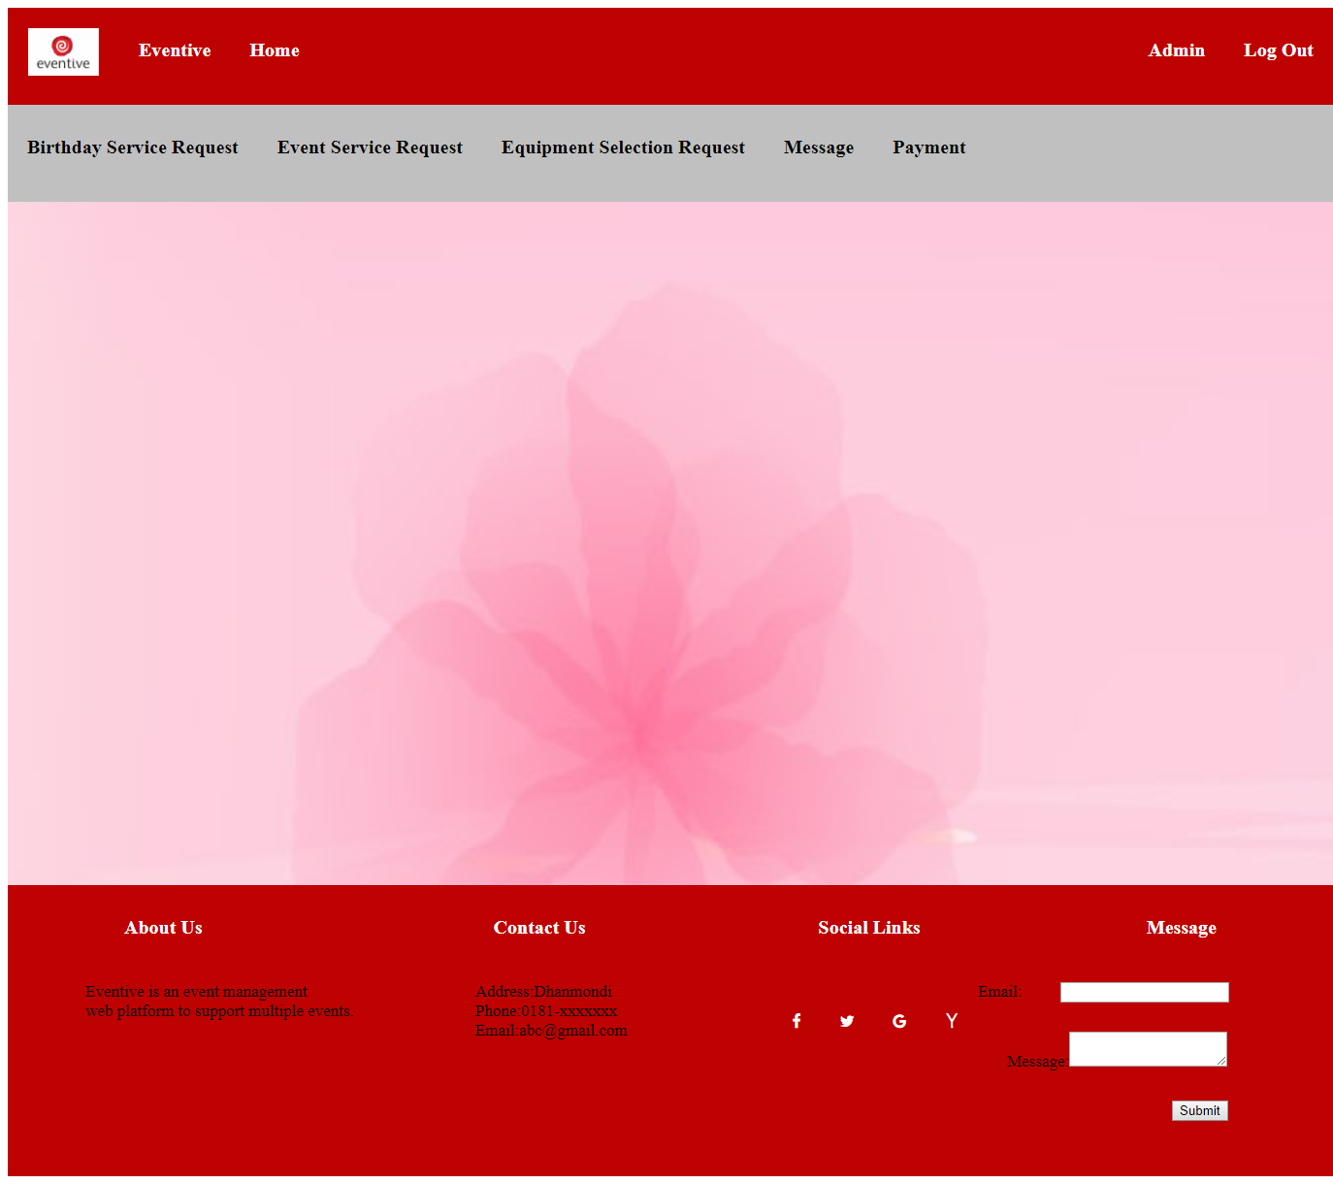
Admin
Admin will have full control over taking services,payment and messaging option.If user gives any request then admin will approve this.

